Slide 1


Dr. D. Y. Patil Pratishthan's Institute for Advanced Computing and Software Development
DAY 9C Programming

Slide 2
Pointer to a Structure
Student s1;
Student *ps;
ps=&s1;
Puts(ps->name);//accessing number using pointer
s1
2000 ps
rollno | name | marks
2000

Slide 3
Pointer to a Structure
The pointer points to the entire structure.
This is useful when the structure is passed to a function.
Only the base address of the structure is passed to the function instead of entire structure by value.

Slide 4
Passing Structure to a function
A structure can be passed as a parameter to a function as
Individual structure members.
Entire structure by value
Entire structure by address.

Slide 5
Array of Structure
To hold a number of record of similar type ,array of structures is used.
Student s1[5];
All records of same type at contiguous memory locations
The array can be initialized at the time of declaration
Student s1[2]={(1,”abc”,80.7},{2,”xyz”,70.3}};
S1[0].rollno | S1[0].name | S1[0].marks
S1[1].rollno | S1[1].name | S1[1].marks
S1[2].rollno | S1[2].name` | S1[1].marks

Slide 6
Union
A user defined type that stores different data types in the same memory space (but not simultaneously).
Declared in the same way as structures.
Size of the union is the size of its largest data type.
union employee
{
Int empid;
double salary
};

Slide 7
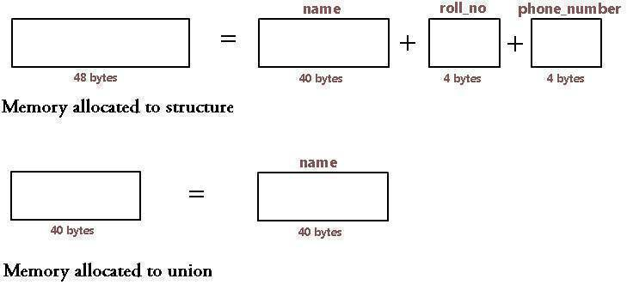
Memory Representation of union

Slide 8
Point to Remember
Union elements are accessed using the same method used for accessing structure elements, using dot or period(.)operator or arrow(->)operator.
The name of a structure member represents the offset of that member from the start of the structure. In union all members start at the same location in memory.
The operations performed on union are same as on structures-accessing union members, taking address, assignment of entire union variable to other union variable

Slide 9
Enum
A user defined data type which consists of set of named integer constants.(symbolic names represent integer constants.
Each member starts from 0 by default and is incremented by 1 for each next member.
enum actype{SAVING=100,FIXED,RECURRING}
enum actype at;
At=SAVING;
printf(%d”,at);//100

